Slide 1
Kickstarting a culture of observability and data-driven devops
Dr. Rajesh Raman (rajesh@signalfx.com)
Chief Architect
SignalFx Inc
June 12, 2019

Slide 2
A little history …
Origin of DevOps per Wikipedia
2007/2008 - Agile Infrastructure - Patrick Dubois and Andrew Clay Shafer
Frustration over separation and lack of cohesion between application methods and infrastructure methods
2009 - “10+ Deploys per Day: Dev and Ops Cooperation at Flickr” by John Allspaw and Paul Hammond
2009 - First Devopsdays conference

Slide 3
My first job: QUIQ inc (2000)
Collaboration-based customer service product
< 10 servers, < 5 services
Totally conventional:
Developers wrote code
Operations team built, deployed, ran systems
Great company, but unfortunately didn’t survive the dot com explosion

Slide 4
My second job: GOOGLE INC (2002)
30,000+ cheap (almost disposable) servers (and doubling every year)
100+ internally and externally facing services
Very sophisticated fault-tolerant distributed systems (map-reduce, GFS, etc.)
Shortly afterwards: Stubby (~gRPC), Chubby (~zookeeper), Dapper (tracing)
Large-scale metrics and logging system

Slide 5
My second job: GOOGLE INC (2002)
I worked in the Production Team
Worked on Google’s “infrastructure-as-a-service”
Included engineers that worked with search team to manage search infrastructure
Wrote cluster management software and responsible for running/operating them
A common pattern in most Google engineering teams
Google had DevOps before it was called DevOps

Slide 6
My THIRD job: FACEBOOK INC (2009)

Slide 7
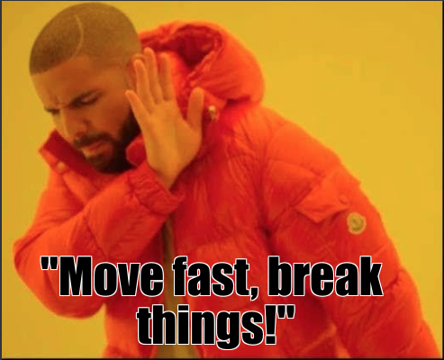
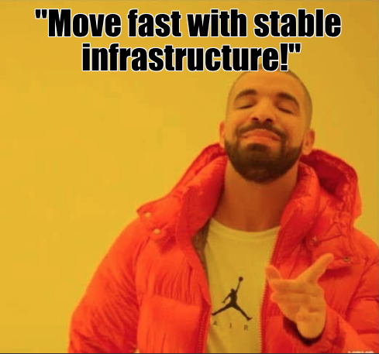
My THIRD job: FACEBOOK INC (2009)

Slide 8
My THIRD job: FACEBOOK INC (2009)
How do you move fast without breaking things?
As with Google, Facebook had a strong culture of observability
A rich suite of internal observability tools:
Large-scale metrics system - ODS
Log aggregation - Scribe
Records/Events - Scuba

Slide 9
You are not google/facebook/$GIANT_COMPANY
Not everything Google, Facebook, etc. do is necessary or appropriate.
BUT
These companies have built extremely sophisticated and complicated systems.
They have experienced the pain of running and debugging these systems.
Experience manifests as certain organizational practices and cultural ethos.
It’s a good idea to learn from their best practices when applicable.

Slide 10
REST OF THIS TALK
What observability is, and why you care
Observability in your team
Adopting an observability mindset
Tools and instrumentation
Using observability data
Spreading adoption in your organization

Slide 11
Why observability MATTERS
Fundamental tension between personas:
Developers: The job is to make changes
Operators: Change is the enemy of stability
Bottom-line:
The environment is constantly changing:
Code, Configuration, Workload, Libraries, Kernels, etc.
Systems fail in innumerable, unpredictable and exotic ways
Failure is not an option - it is inevitable
Observability lets you handle/manage change and move forward

Slide 12
MONITORING vs OBSERVABILITY
Monitoring: Is it working?
Detect problems affecting your customers
Black-box (e.g., health check) vs white-box monitoring (e.g., based on service metrics)
Fundamentally reactive in nature
Observability: What/how is it doing?
Improve insight into complex systems
Enhance understanding of changes
Visibility into internal state
Many proactive interactions

Slide 13
OBSERVABILITY IN YOUR ORGANIZATION
Observability is a methodology that needs to be practiced
People tend to unfortunately focus on tools
Observability is not a boolean state
Observability is a team sport
Uneven participation leads to blind spots
Most effective when practiced organization-wide
Adoption of observability practices cannot be decreed from above
… but the organization can centrally enable teams to adopt observability

Slide 14
OBSERVABILITY IN YOUR TEAM
Observability and scrum have many things in common.
Like scrum-based development, observability is a “team sized” activity
A team is the right-sized unit to exercise the practice
Requires the whole team to participate
Appears to add process and overhead…
… but actually increases speed, efficiency and confidence
Shares many of scrum’s values
Scrum values: Focus, Openness, Respect, Courage, Commitment
But let’s add responsibility!

Slide 15
RESPONSIBILITY
Your simple code modification can cause an outage two months from now
You might not be the one who gets paged
Put yourself in the shoes of your teammate who gets woken up at 3 a.m.
They might not be a domain expert on your subsystem
What context should be provided to understand how your subsystem is operating?
Observability is required to develop and deploy software responsibly
Breakages cost money, stress and aggravation
Need to mitigate risks when operating and modifying the system
ROAM process: Resolved, Owned, Accepted, Mitigated
Ensure respect and empathy for your fellow on-callers

Slide 17
DEVELOPING WITH AN OBSERVABILITY MINDSET
Don’t launch to a boolean – launch to a metric
Measure what you aim to fix or improve
Deploy the measurement before you work on your feature
Track the metric to demonstrate value
What’s in your “Definition of Done”?
Code is documented?
Code is tested?
Include:
Code is instrumented
Charts/alerts created
Runbooks updated
What would you need to understand what your system is doing, and debug it at 3 a.m.?

Slide 18
What SHOULD YOU INSTRUMENT?
Different mechanisms for getting information from systems
Traces
Metrics
Logs
Largely complementary, but each is capable of standing alone
Different capabilities, levels of complexity, use cases
If you’re just getting started:
Don’t sweat it: anything is better than nothing
Consolidating in one method is better than peanut-buttering
If you are able to choose, pick tracing

Slide 19
WHAT YOU SHOULD MONITOR: KPI’s AND SLX’s
Monitoring should alert on customer-visible symptoms
KPI: Key Performance Indicator
Conveys health/status, performance, usage, etc.
KPIs may change if system implementation or architecture changes
SLI: Service Level Indicator
Measurement of your user’s expectations, perhaps derived from several signals
SLIs should not change unless user needs change
SLO: Service Level Objective
An SLI with tolerance thresholds that denote acceptable levels of service
SLA: Service Level Agreements
Contract with your customers
Not your business, unless you are a lawyer

Slide 20
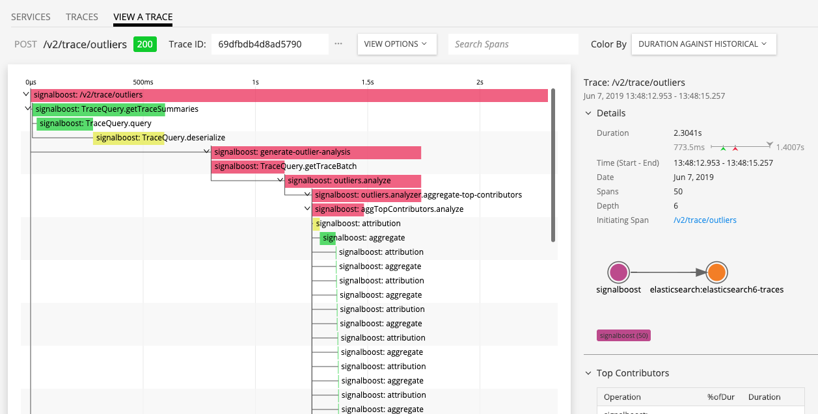
TRACES: TRANSACTION ORIENTED OBSERVABILITY
Traces capture transaction flow through components/systems
Rich metadata includes service names, operations, arguments
Helps quickly localize problems
RED metrics:
Requests
Errors
Durations
Need custom instrumentation code
Capture relevant operations
Propagate context to downstream systems

Slide 21
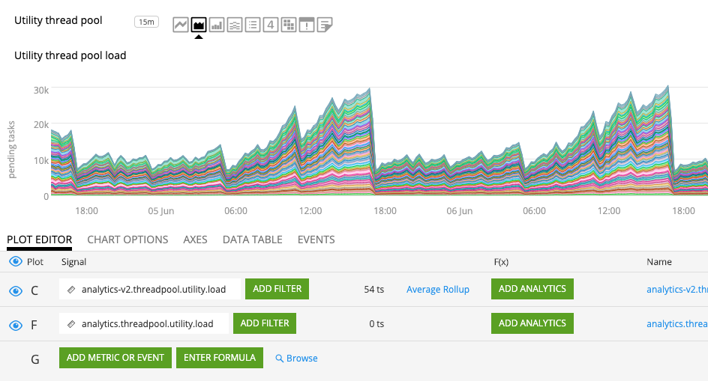
METRICS: WORK AND RESOURCE ORIENTED OBSERVABILITY
Compact, precise, ubiquitous
Naturally amenable to visualization, analytics, etc.
Work metrics:
Throughput, number of widgets, etc.
Resource metrics: USE
Utilization
Saturation
Errors
Don’t forget software resources
queues, caches, thread pools, locks

Slide 22
LOGS: EVENT ORIENTED OBSERVABILITY
Everyone’s most familiar method
Everything from scraped stdout to structured loggers
Very flexible but very uneven in signal-to-noise ratio
More structure is better:
Common: Timestamps, log levels, thread names, classes
Custom fields: database query times, context from request
Can extract metrics for visualization

Slide 23
OBSERVING THE OBSERVABLES
Even moderate levels of instrumentation can yield very large amounts of data
Easy to get lost/disoriented on how to structure and consume this data
Consume == visualization, alerting, automation, etc.
Imagine yourself in your grumpy, sleep-deprived 3 a.m. avatar
Monitoring: CASE methodology
Context-heavy: Help responder understand system context
Actionable: If the responder can’t do anything, why bother?
Symptom-based: Focus on KPIs and SLIs rather than internal state
Evaluated: Ensure alerts are exercised and revisited to check validity and utility
Observability: We can also draw inspiration from other domains

Slide 24
ECAM

Slide 25
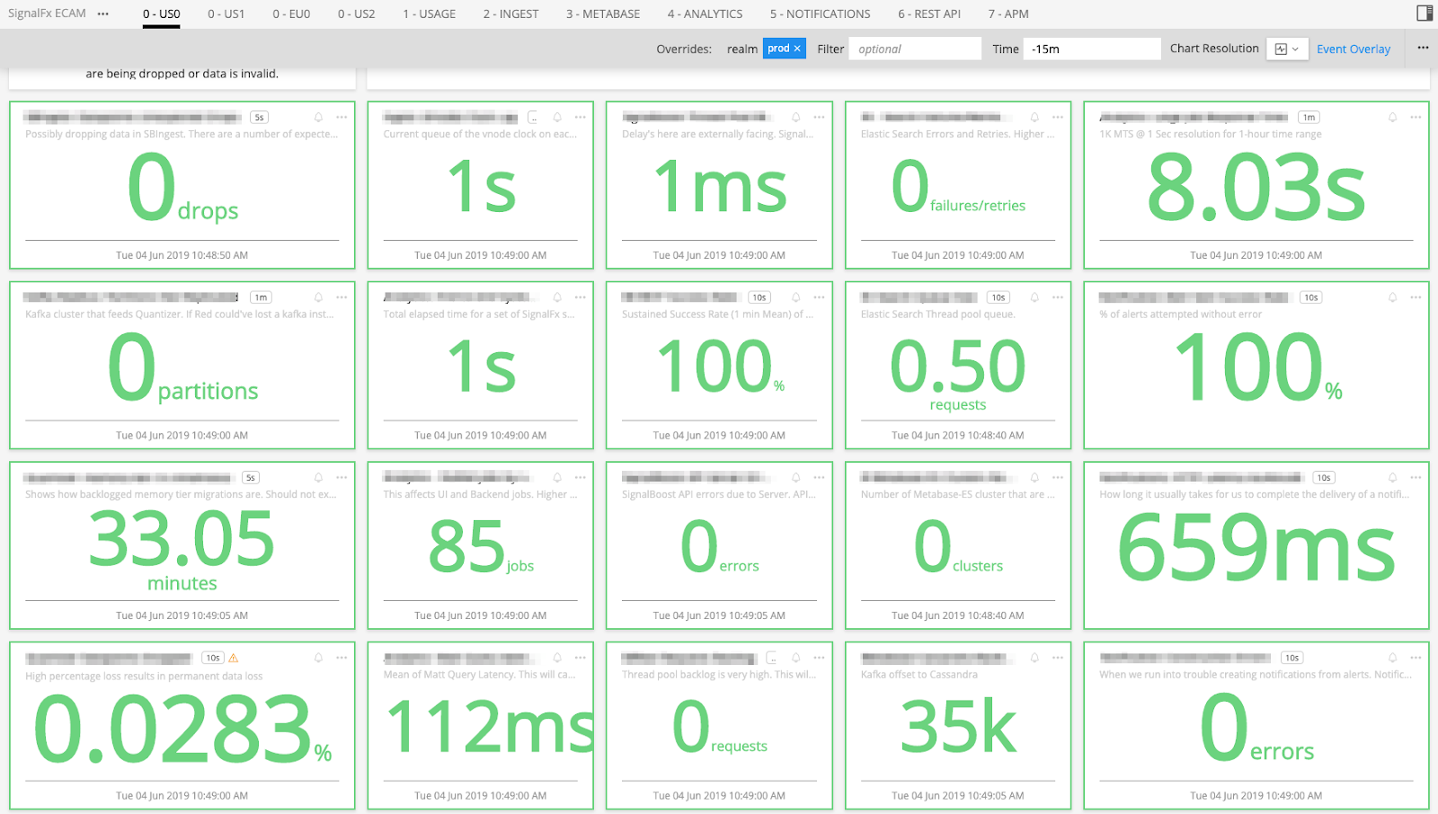
HIGH-LEVEL GLOBAL SINGLE SOURCE OF TRUTH
Global single pane of glass provides an organization-wide source of truth
Key system-wide SLIs and KPIs are displayed
SLO violations are colored red
Buttons to drill-down to individual sub-system displays

Slide 26
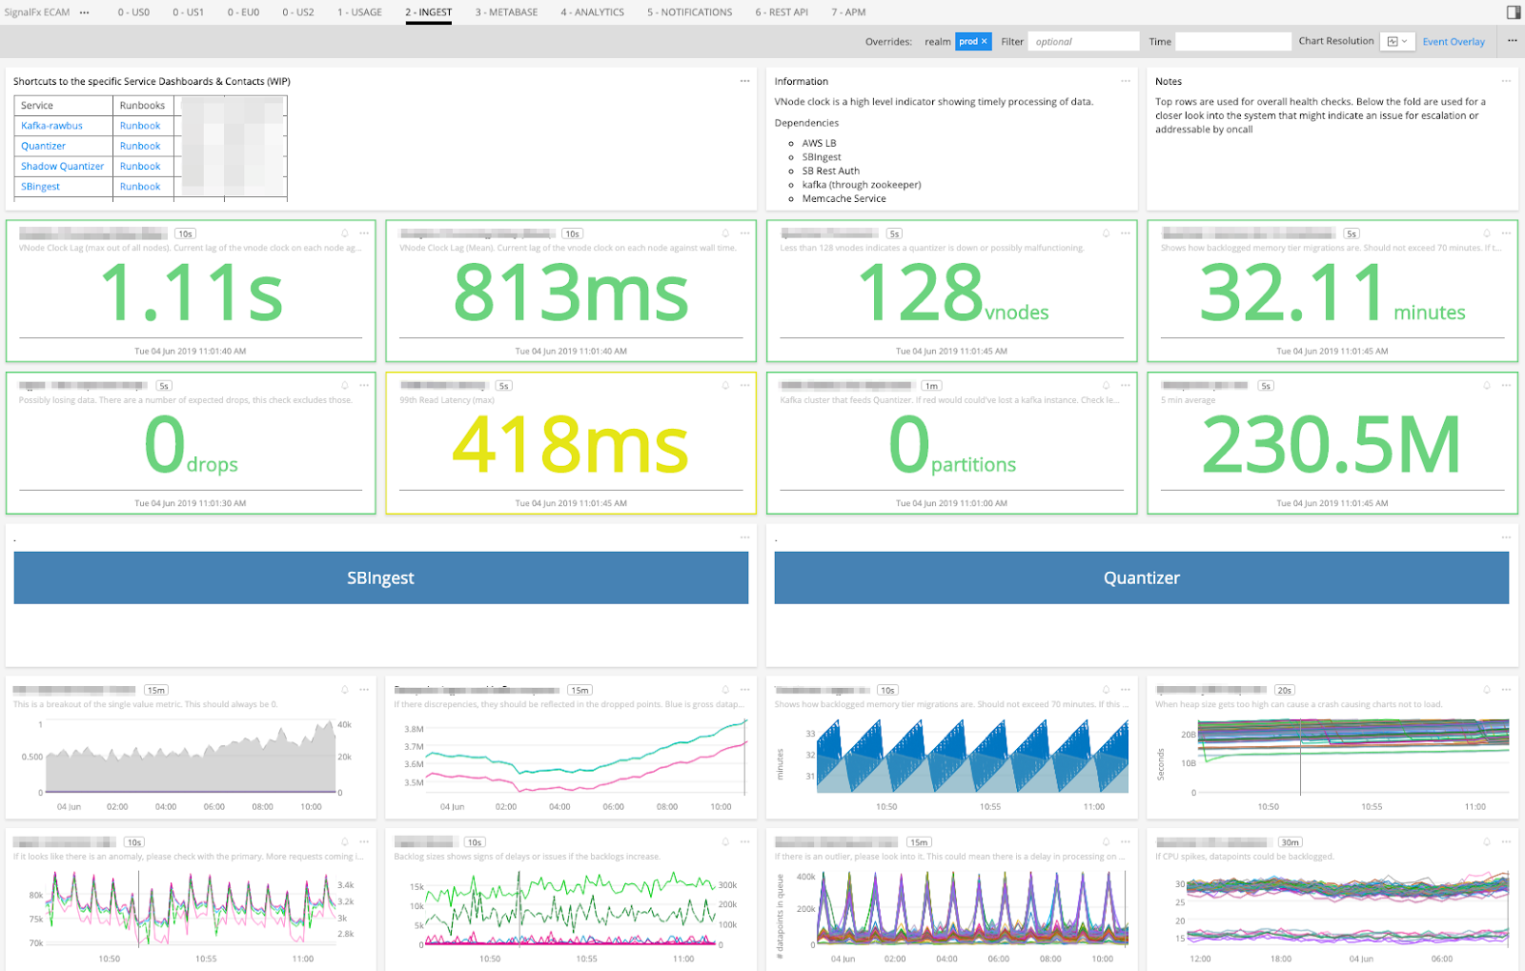
DETAILED PER-SERVICE DRILL DOWNS
Individual sub-systems provide detailed visibility into KPIs.
KPIs include work, software resource and hardware resource metrics.
Links to runbooks and contextual documentation embedded into the dashboard.
Runbook links are also included in individual alerts.

Slide 27
USING YOUR NEW SUPERPOWERS

Slide 28
USING YOUR NEW SUPERPOWERS
Build a mental model of your system
Traces give a very useful illustration of system interactions
Become familiar with your dashboards and how they appear under normal operation
In steady state
When deploying
Daily/Weekly/Seasonal patterns
Flag bad deploys by observing KPIs and SLIs
CI/CD/CI: follow-up CI/CD with Continuous Improvement
Observability data often indicates opportunities for improvements and tuning
Encourage curiosity and data exploration
Interesting or unexpected patterns often lead to better understanding

Slide 29
USING METRICS IN TEAM ACTIVITIES AND RITUALS
Team/group meetings
General review of system status
Capacity reviews
Celebrate growth milestones
Sprint And Launch retrospectives
Track value/work metrics for post-launch follow-up
Incident Reviews
Embedded charts in incident reviews provide instant context
Can immediately show scope and severity
Identify observability gaps, opportunity to close the loop and improve

Slide 30
STIGMERGY(*)
Good observability practices can spread virally
Show everybody what “good” looks like
Help adjacent groups adopt these practices:
It benefits you if the systems that you depend on are observable
Recruit an influencer
They can make the difference getting to critical mass
When there’s critical mass, observability will be adopted and enabled by the organization
Dedicated centralized service bureau and observability enablement teams
Consolidation of tools and practices
Cross-team and cross-system observability
(*) Thank you Cory Watson!

Slide 31
SUMMARY
Observability is a critical capability in an uncertain world
Efficient reactive debugging
Proactive development and operations
Observability is a practice
Inculcate a mindset around capturing and using data
Don’t launch to a boolean – launch to a metric
What’s your definition of done?
Observability is a team sport
A team is a right place to get started
Exercise observability with your devops team in mind
Show what good looks like – make it spread virally
When there’s critical mass, observability can be adopted organization-wide
Centralized enablement and tooling

Slide 32
QUESTIONS?

